Slide 1
LOGIN SCREENS
martin.reid@solent.ac.uk

Slide 2
On boarding
Sign up
login
Sign in

Slide 3
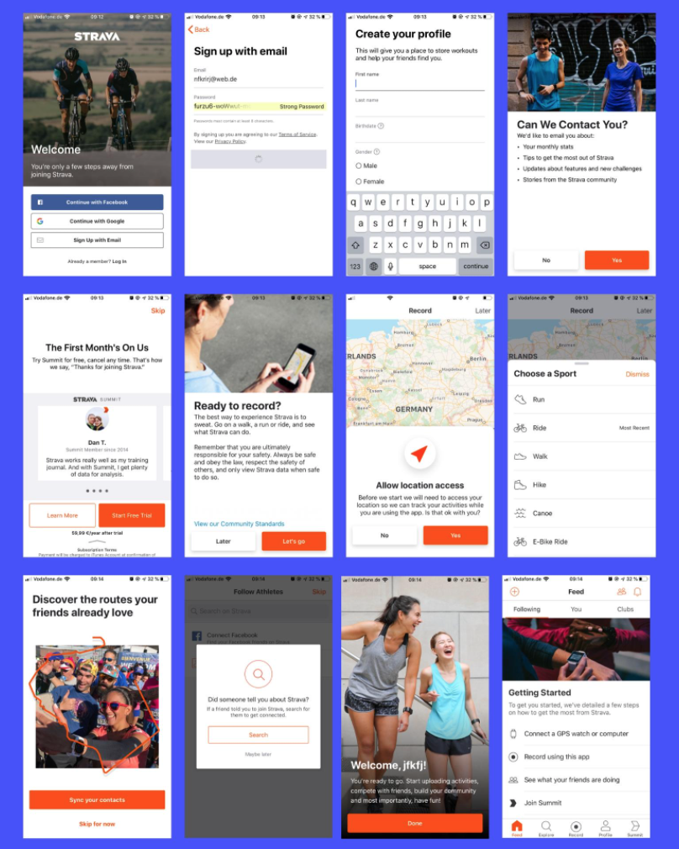
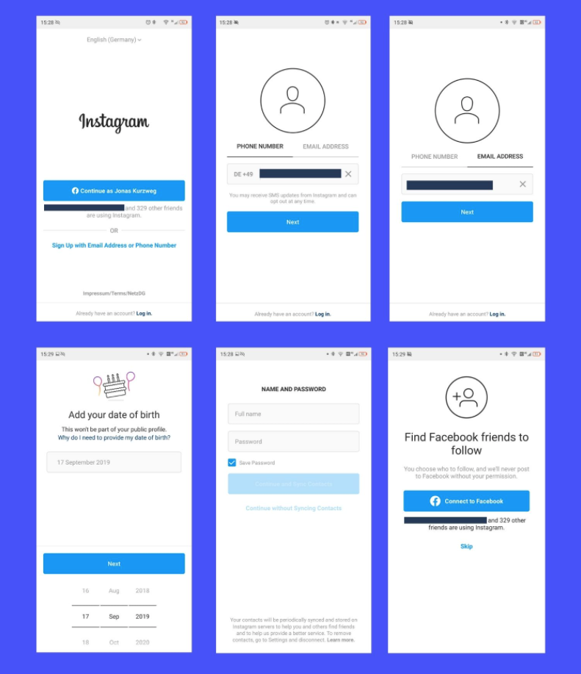
UXCAM., 2025. 10 Apps with the Best User Onboarding Flows 2020 | UXCam [viewed 25 October 2025]. Available from: https://uxcam.com/blog/10-apps-with-great-user-onboarding/

Slide 4
Heuristics are mental shortcuts that help people make quick decisions. They are rules or methods that help people use reason and past experience to solve problems efficiently. Commonly used to simplify problems and avoid cognitive overload, heuristics are part of how the human brain evolved and is wired, allowing individuals to quickly reach reasonable conclusions or solutions to complex problems.
INVESTOPEDIA., 2025. Heuristics [viewed 20 October 2025]. Available from: https://www.investopedia.com/terms/h/heuristics.asp
‌

Slide 5

THE ANIEROBI, 2021. Usability heuristics for cognitive disabilities. - UX Planet [viewed 20 October 2021]. Available from: https://uxplanet.org/usability-heuristics-for-cognitive-disabilities-6988266e42e8

Slide 6
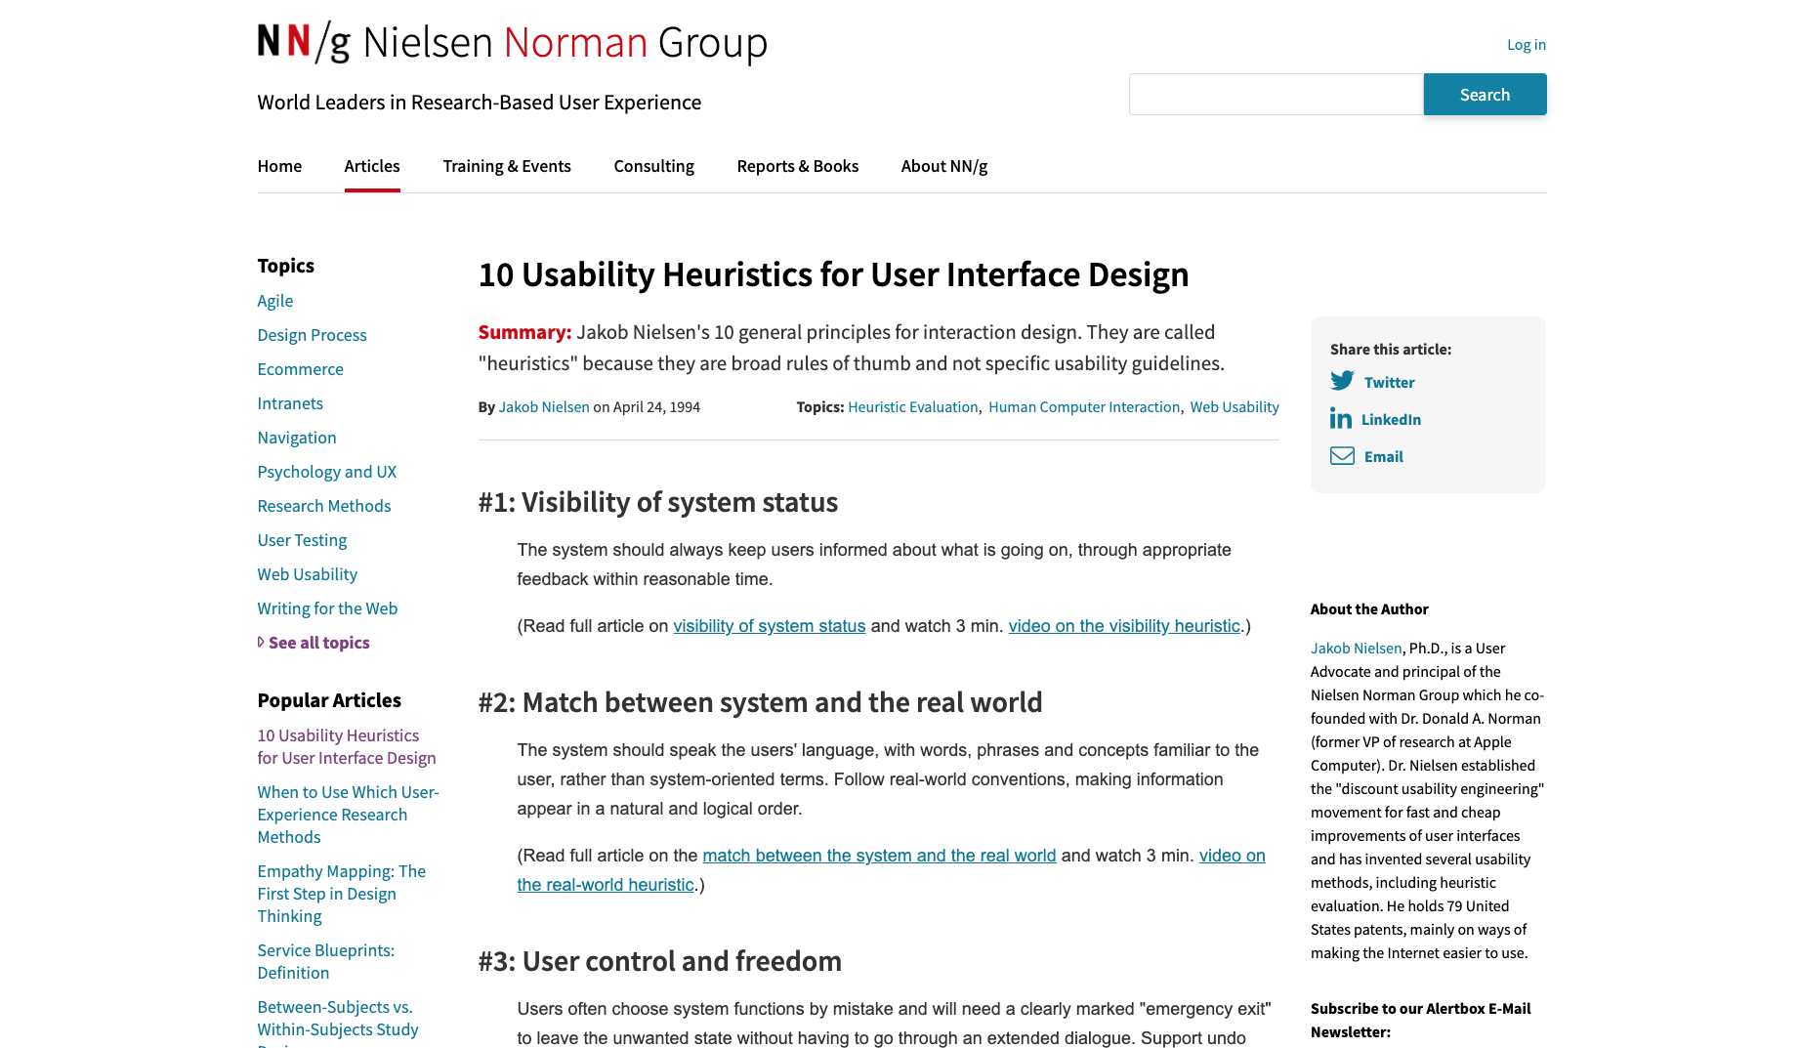
Nielsen., J. 2019. 10 Heuristics for User Interface Design: Article by Jakob Nielsen [viewed 25 October 2025]. Available from: https://www.nngroup.com/articles/ten-usability-heuristics/

Slide 7
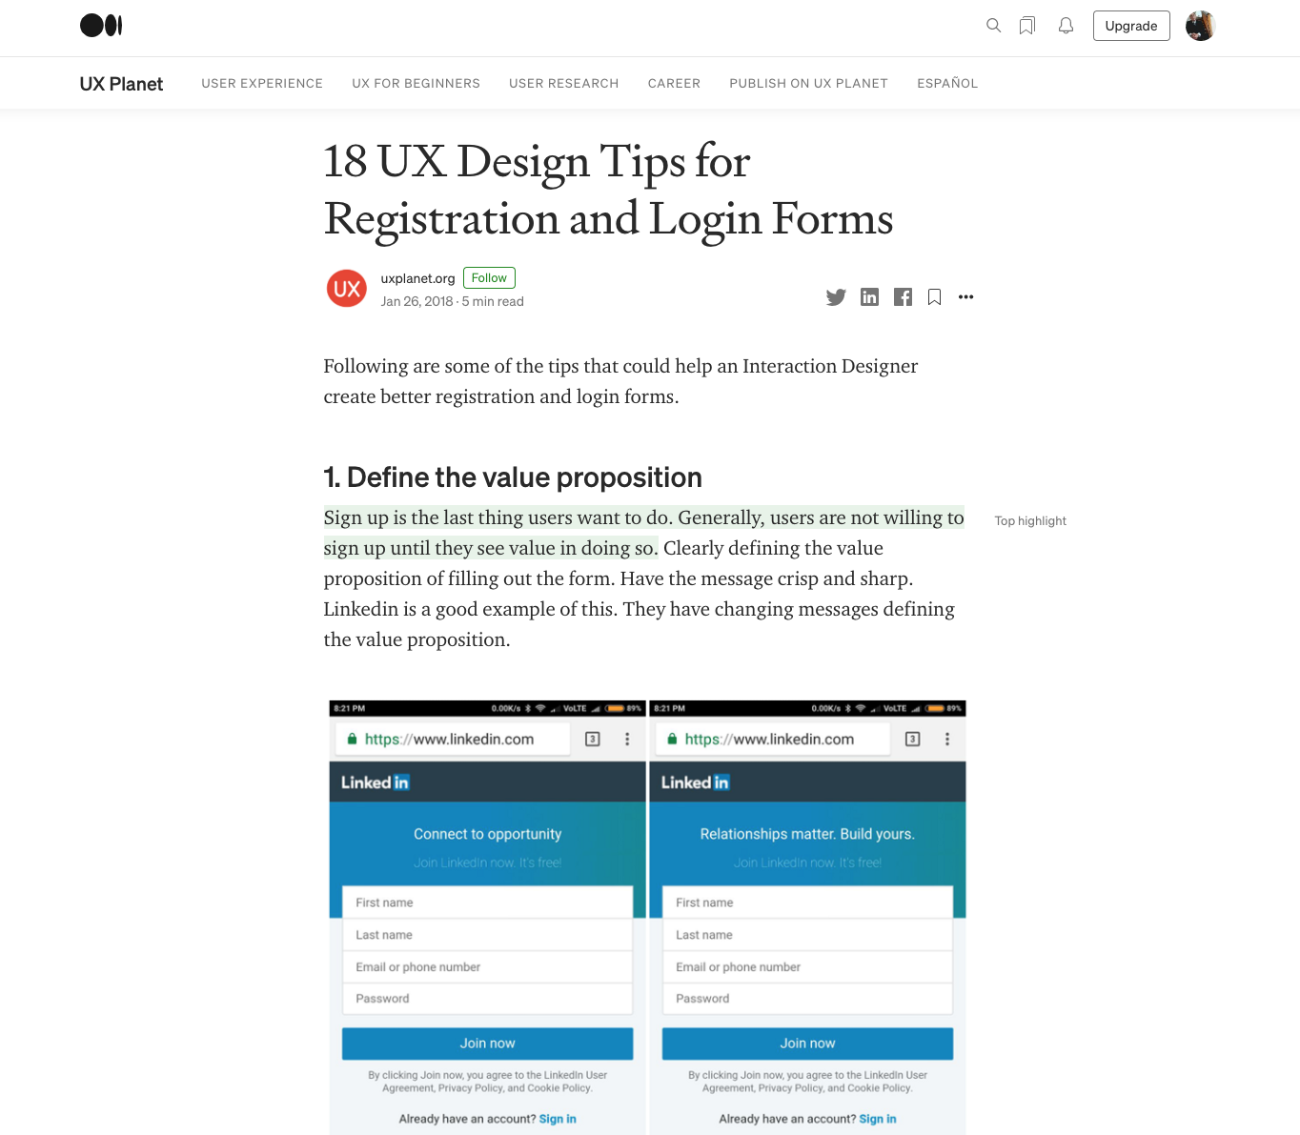
UXPLANET.ORG, 2018. 18 UX Design Tips for Registration and Login Forms - UX Planet [viewed 25 October 2020]. Available from: https://uxplanet.org/18-ux-design-tips-for-registration-and-login-forms-f897557358ba

Slide 8
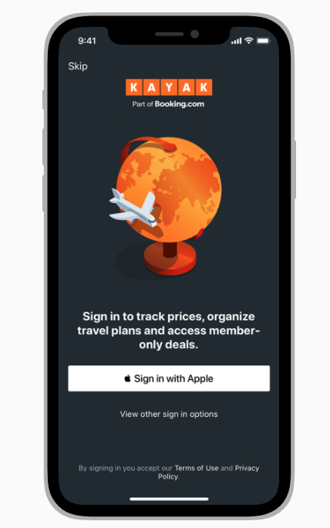
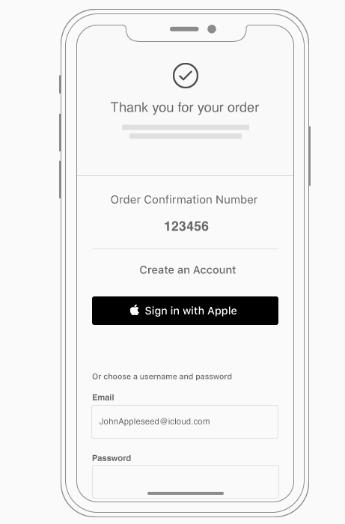
Apple Sign in
If your app requires signing into an account, display a brief, friendly explanation on the login screen that describes the reasons for the requirement and its benefits. Also, remember that not everyone using your app has an account from the start.
APPLE., 2020. Introduction - Sign in with Apple - Human Interface Guidelines - Apple Developer [viewed 25 October 2020]. Available from: https://developer.apple.com/design/human-interface-guidelines/sign-in-with-apple/overview/introduction/

Slide 9
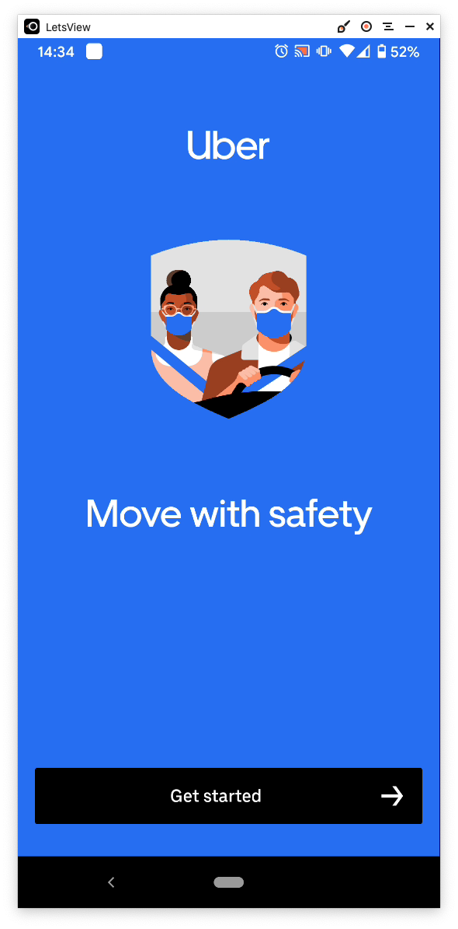
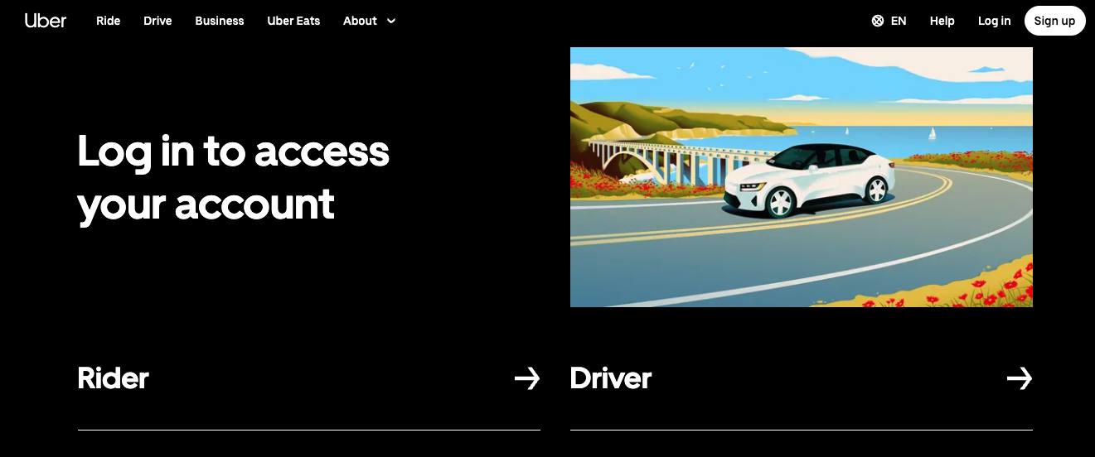
https://www.uber.com/global/en/sign-in/

Slide 10
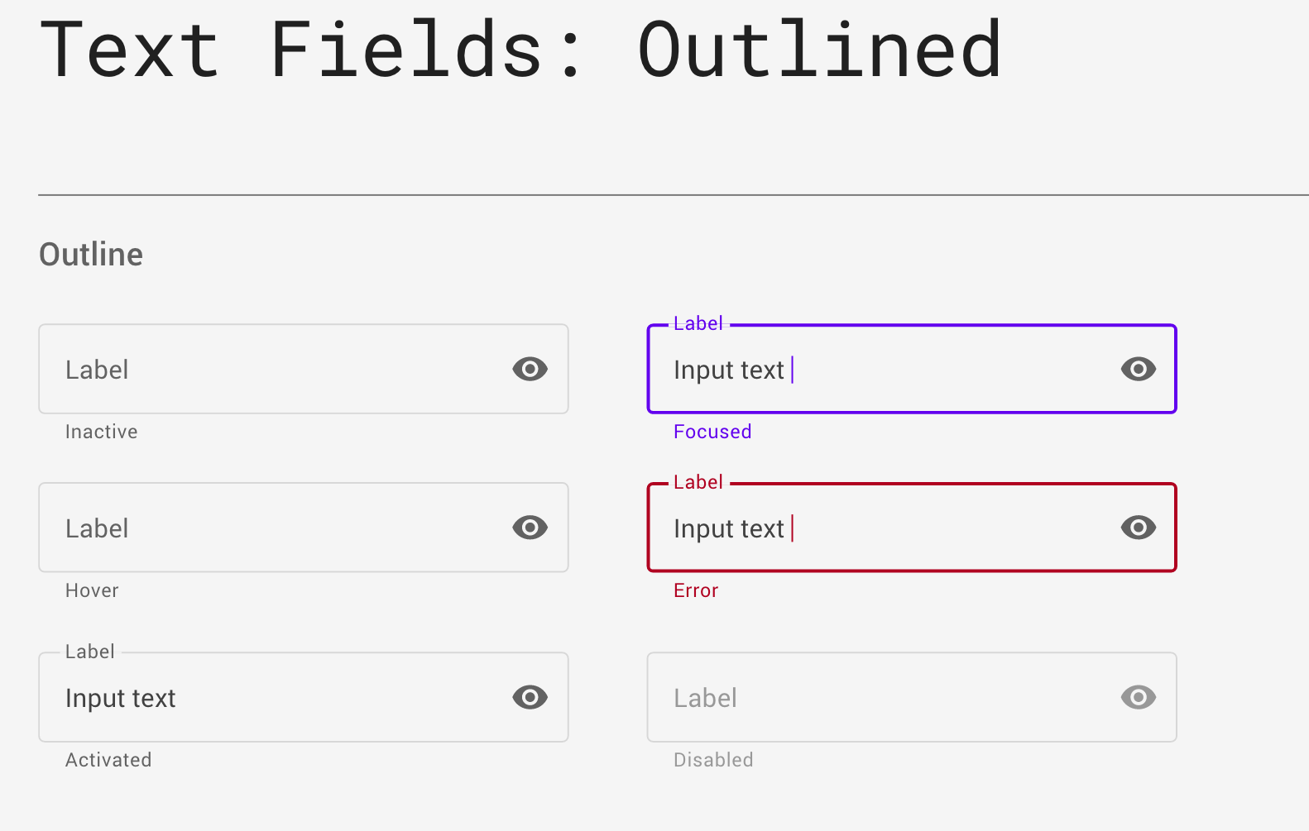

Slide 11
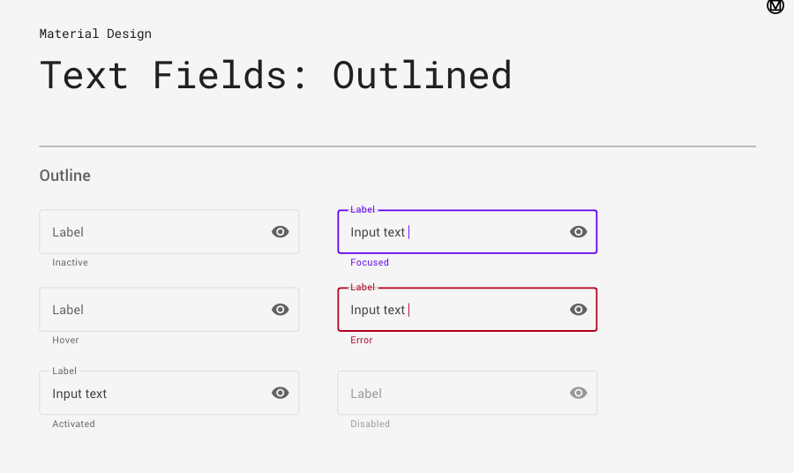

Slide 12
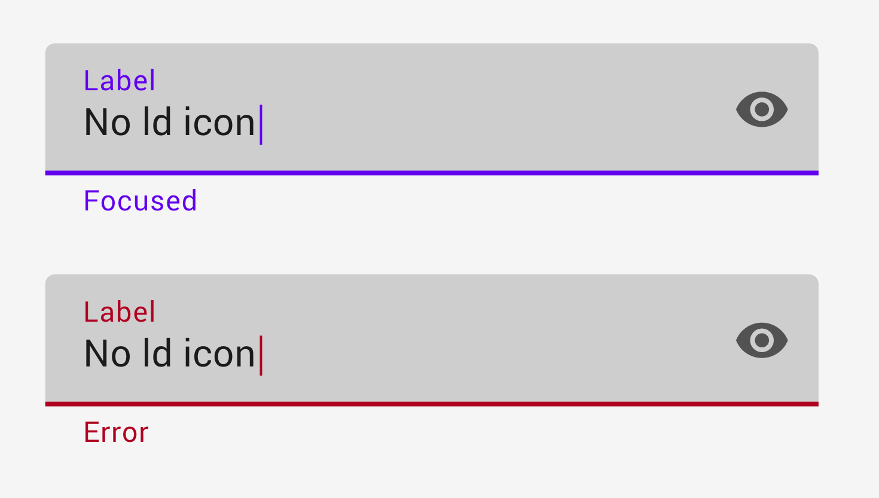

Slide 13
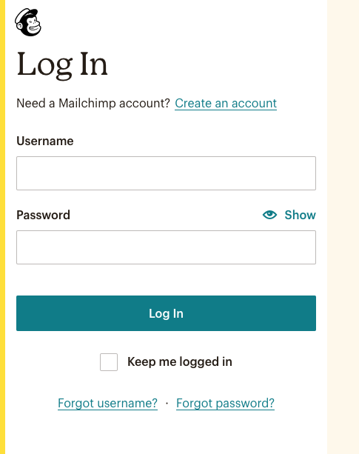
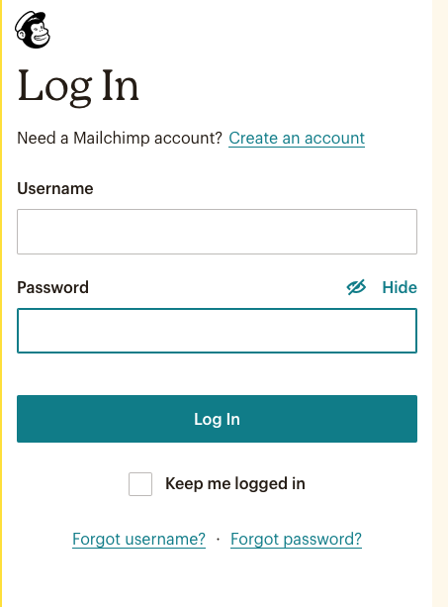

Slide 14
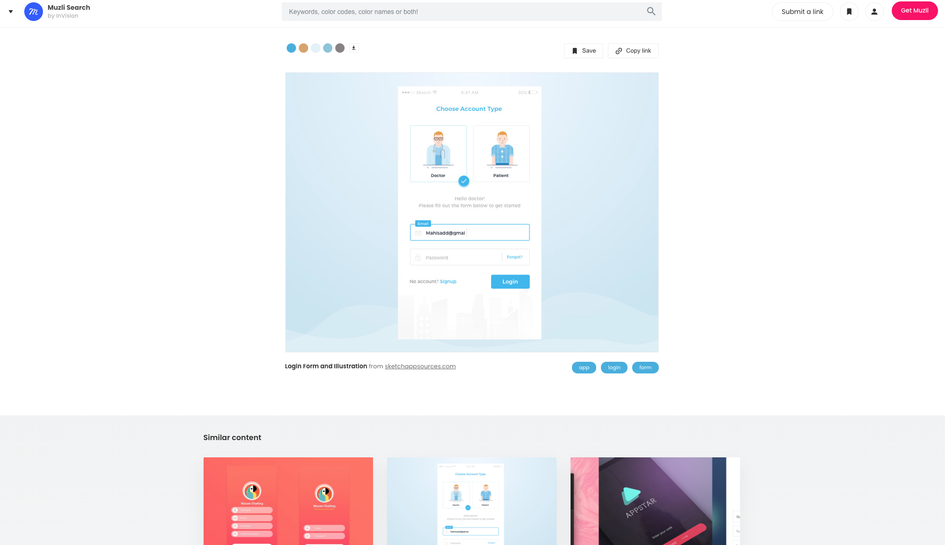
MUZILI., 2020. 439+ Login screens design inspiration, ideas and examples - Muzli Design Inspiration [viewed 25 October 2020]. Available from: https://search.muz.li/inspiration/login-screen/
‌

Slide 15
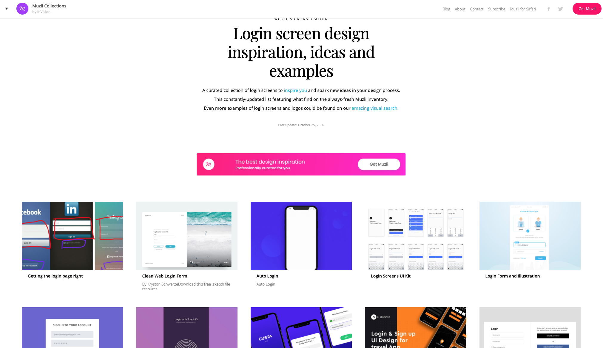
MUZILI., 2020. 439+ Login screens design inspiration, ideas and examples - Muzli Design Inspiration [viewed 25 October 2020]. Available from: https://search.muz.li/inspiration/login-screen/
‌

Slide 16
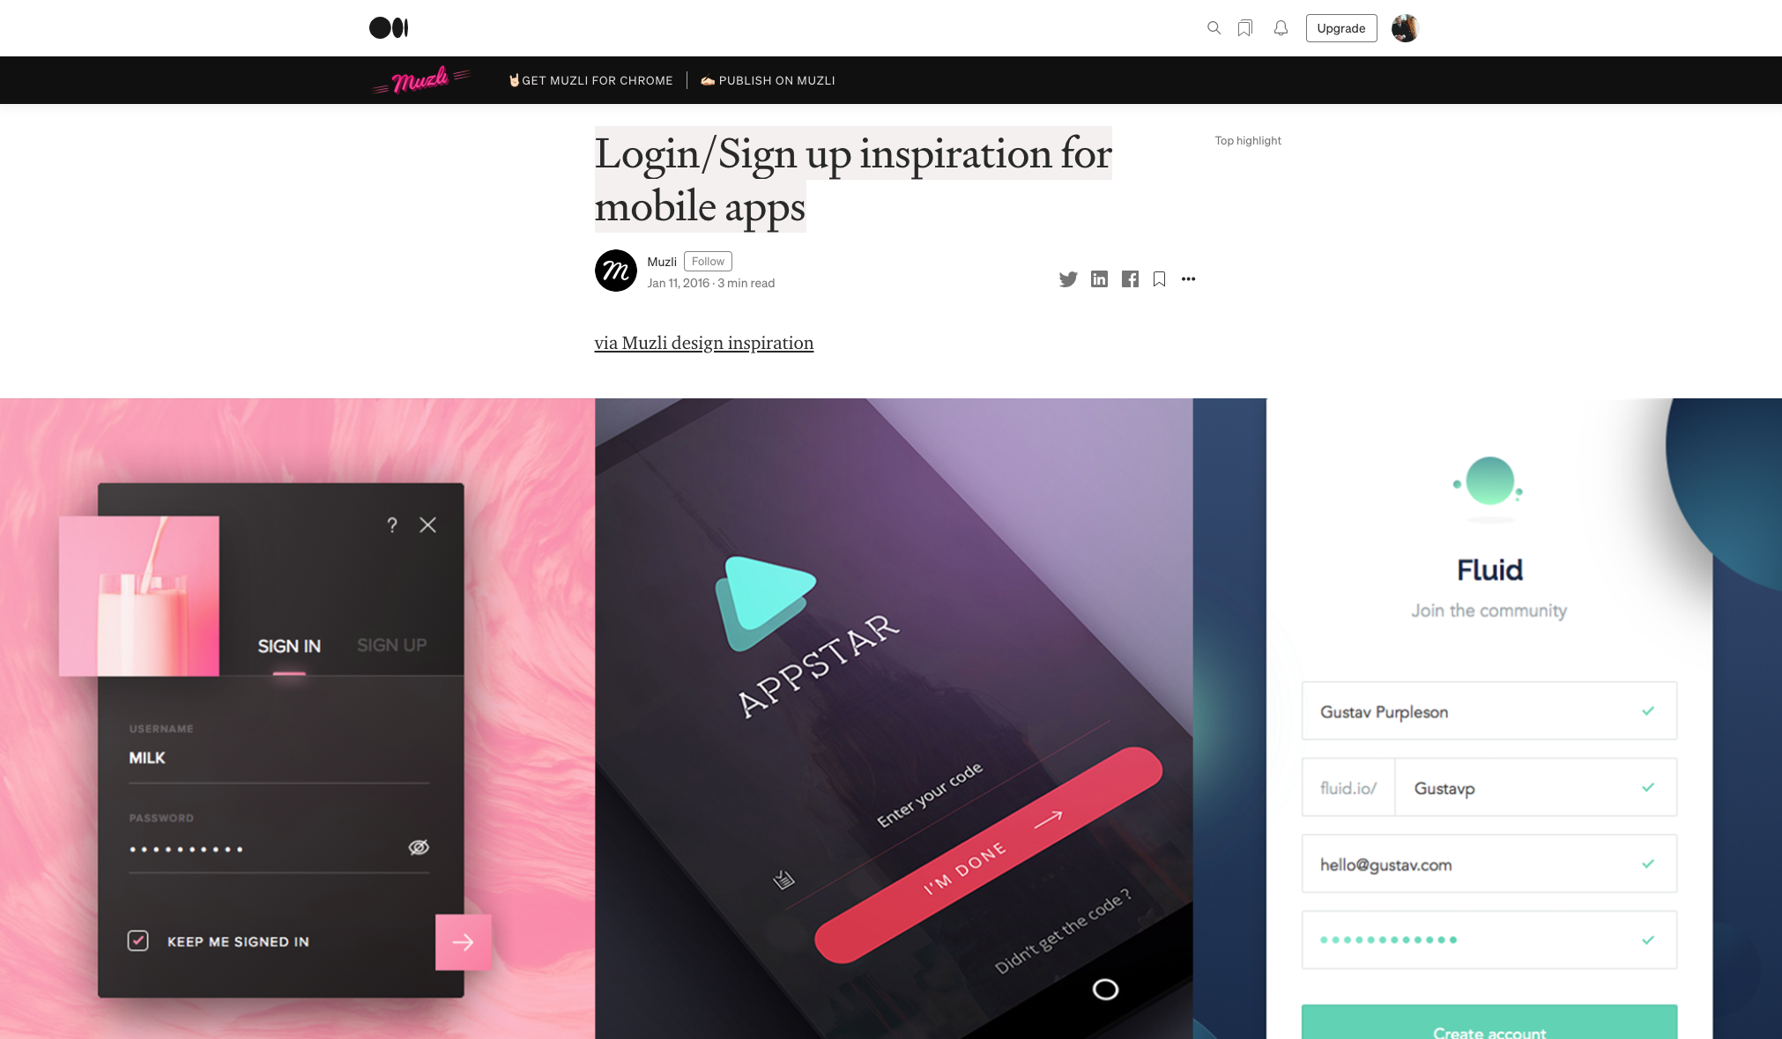
https://medium.muz.li/login-sign-up-inspiration-for-mobile-apps-aeff34090bbd

Slide 17
LOGIN SCREEN DESIGN TASK

Slide 18
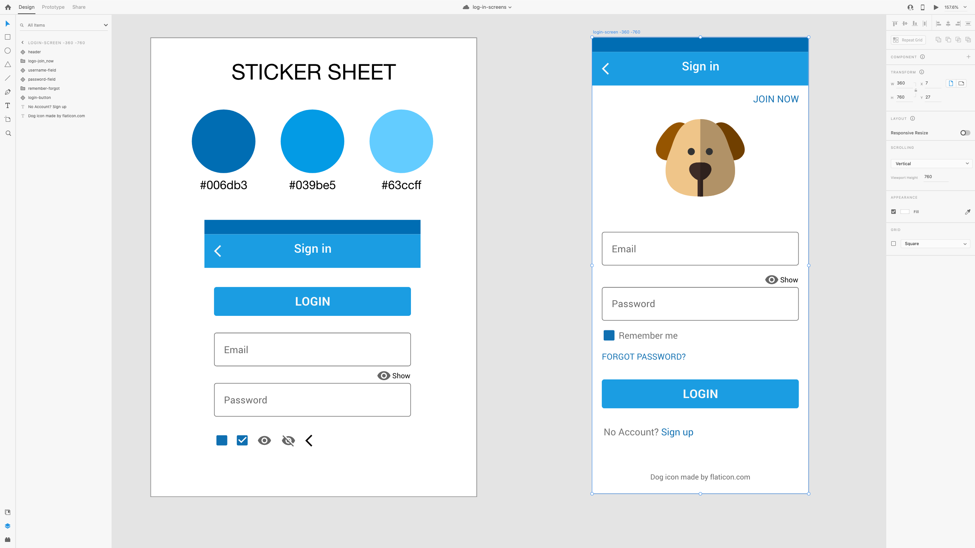

Slide 19
